Slide 1
Twitch Switch Programmer Diagram

Slide 2
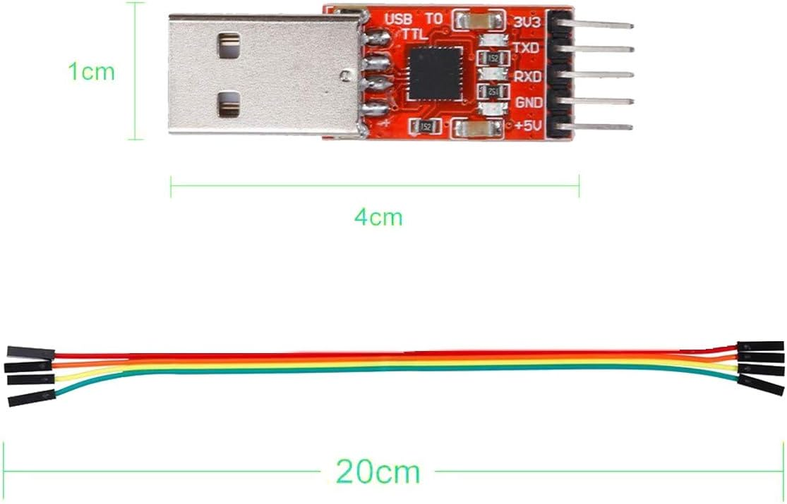
3v3
TXD
RXD

Slide 3
3v3
TXD
RXD

Slide 4
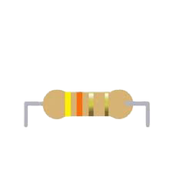
Solderless Breadboard
 | a | b | c | d | e
1 |  | 3v3
2 |  | TXD
3
4 |  | RXD |  |  | GND
5 |  |  |  |  | Mid
CP2102 Programmer
Twitch Switch Sensor PCB
3v3
Diode
VCC
TXD
GND
RXD

Slide 5
Solderless Breadboard
 | a | b | c | d | e
1 |  | 3v3
2 |  | TXD
3
4 |  | RXD
5
CP2102 Programmer
3v3
TXD
RXD

Slide 6
Solderless Breadboard
 | a | b | c | d | e
1 |  | 3v3
2 |  | TXD
3
4 |  | RXD
5
CP2102 Programmer
3v3
TXD
RXD

Slide 7
Solderless Breadboard
 | a | b | c | d | e
1 |  | 3v3
2 |  | TXD
3
4 |  | RXD
5
CP2102 Programmer
3v3
Diode
TXD
RXD

Slide 8
Solderless Breadboard
 | a | b | c | d | e
1 |  | 3v3
2 |  | TXD
3
4 |  | RXD |  |  | GND
5 |  |  |  |  | Mid
CP2102 Programmer
Twitch Switch Sensor PCB
3v3
Diode
VCC
TXD
GND
RXD

Slide 9
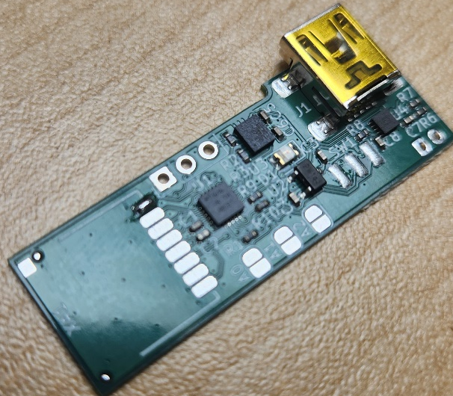
 | a | b | c | d | e
1 |  | 3v3
2 |  | TXD
3
4 |  | RXD |  |  | GND
5 |  |  |  |  | Mid
CP2102 Programmer
Diode
3v3
TXD
RXD

